Slide 1
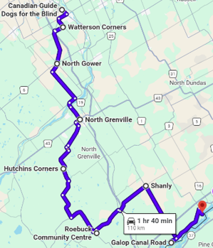
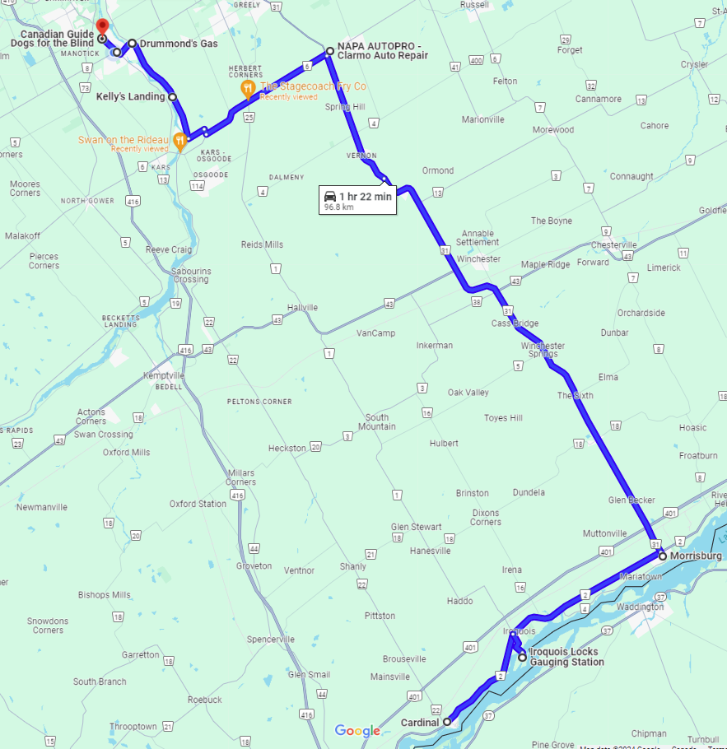
GUIDE DOG RIDE ROUTE 2026
PART A
Start – Canadian Guide Dogs for the Blind, 4120 Rideau Valley Dr. North
Rt onto CR 13, Rideau Valley Dr. N for 2 km
Rt onto CR 8, Bankfield for 2 km
Lt onto Firstline Rd for 2.2 km
Rt onto Century Rd E for 7.5 km
Rt onto Route 5 for 12 km
Lt onto Merlyn Wilson Rd for 1 km
Continue CR 44 for 3km
Rt onto CR 43 for 1.5 km
Lt onto CR 18 for 11.5 km
Rt onto CR 18 – STOP: ROEBUCK
Rt onto CR 21 for 6.8km
Rt onto CR 44 for 450m
Lt onto CR 21 for 8.1 km
Lt onto CR 22 Shanly Rd for 13.4 km
Rt onto CR 2 for 1.5km
Continue CR 2 for 10.2km
Take 1st exit onto Carmen Rd for 1.7km
PART B
Rt onto Carman Rd. STOP: IROQUOIS
Rt onto CR 2 for 13 km
Lt onto CR 31 (in Morrisburg) for 47 km
Rt onto CR 6 towards Metcalfe for STOP: NAPA AUTOPRO/CLARMO
Rt onto CR 6 for 13.5 km
Rt onto CR 19 River Rd for 11 km
Lt onto CR 8 Mitch Owen for 1 km
Rt onto CR 13 Rideau Valley Dr. N. for 3 km
End – Canadian Guide Dogs for the Blind, 4120 Rideau Valley Dr. North
A
B

